Slide 1

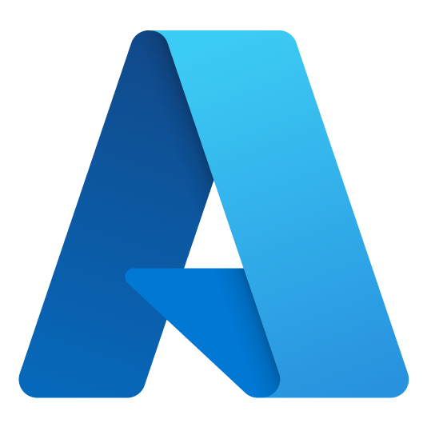



Larry Wall
Cloud Solution Architect
Azure Dev Day
larry.wall@microsoft.com
https://www.linkedin.com/in/larry-wall-58525911
https://github.com/larrywa

Slide 2
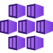
Microservice Solutions
Develop and deploy microservices using Azure Kubernetes Service and Azure Container Registry

Slide 3

Overview of Containers

Slide 4
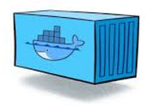
What is a Container?
Portable unit of deployment
Application code and dependencies compartmentalized
Virtualization without the need of a VM overhead
Best practice to organize one service/container
Physical Machine/VM
Container: Product:1.0
Container: Basket:2.0
Container: Product:2.0
Product.API v1
Basket.API v2
Product.API v2
Lib-L v2
Lib-L v3
Lib-L v3
Lib-M v2
Runtime v5
Runtime v7
Runtime v6
Notes:
Portable unit of deployment - Containers are a solution to the problem of how to get software to run reliably when moved from one computing environment to another. This could be from a developer's laptop to a test environment, from a staging environment into production and perhaps from a physical machine in a data center to a virtual machine in a private or public
Application code and dependencies compartmentalized - Simply put, a container consists of an entire runtime environment: an application, plus all its dependencies, libraries and other binaries, and configuration files needed to run it, bundled into one package. By containerizing the application platform and its dependencies, differences in OS distributions and underlying infrastructure are abstracted away.
Virtualization without the need of a VM overhead - With virtualization technology, the package that can be passed around is a virtual machine and it includes an entire operating system as well as the application. A physical server running three virtual machines would have a hypervisor and three separate operating systems running on top of it.
By contrast a server running three containerized applications as with Docker runs a single operating system, and each container shares the operating system kernel with the other containers.
Shared parts of the operating system are read only, while each container has its own mount (i.e., a way to access the container) for writing. Persistent Storage through Volume Mapping
A container may be only tens of megabytes in size, whereas a virtual machine with its own entire operating system may be several gigabytes in size.
Because of this, a single server can host far more containers than virtual machines. Virtual machines may take several minutes to boot up their operating systems and begin running the applications they host, containerized applications can be started almost instantly.
Best practice to organize one service/container
Different versions of software on different environments
Scale out an environment easily
SCALE AS A MONOLITH – today we scale as monolith’s.
DEPLOY WITH ALL THOSE DEPENDENCIES WHICH MAY VARY
Slide Source
https://azure.microsoft.com/en-us/documentation/articles/service-fabric-overview-microservices/
Notes
(1) A monolith app contains domain specific functionality and is normally divided by functional layers such as web, business and data.
(2) You scale monolithic apps by cloning it on multiple servers/VMs/containers.
(3) A microservice application separates functionality into separate smaller services.
(4) This approach scales out by deploying each service independently, creating instances of these services across servers/VMs/containers.
Designing with a microservice approach is not a panacea for all projects, however it does align closer with the business objectives described earlier. Also starting with a monolithic approach may be acceptable if you know that later you have the opportunity to rework the code into a microservice design if necessary. More common is that you have a monolith app today and you can slowly break this apart in stages starting with the functional areas that need to be more scalable or agile.
PUSH THE CONTAINER TO REMOTE MACHINE

Slide 5
What Problems Do Containers Solve?
Guarantees consistency across DEV, TEST and PROD
Increases Productivity
Isolation & Performance
Smaller footprint than VMs
Containers are a great environment for deploying Microservices
Notes:
Guarantees consistency across DEV, TEST and PROD
Provides portability – works across all environments
Increases Productivity
Dramatic reduction in Sprint 0 timelines
Isolation & Performance
Container instances are isolated between services and OS
Smaller footprint than VMs
Optimize density and consolidation
ility to design for very fast, very efficient scaling

Slide 6

Moving to Microservices

Slide 7
Moving to Microservices
Re-platforming a monolith to a microservice–based architecture
Product
Cart
Pricing
Client App
User Interface
P
C
P
Functional application areas decomposed into isolated service
Business Logic
P
C
P
Prod
Cart
Price
By definition, each microservice stores its own data
Data Access
P
C
P
Database
Relational
Doc
Name/
Value
Monolithic App
Notes:
On left - Traditional 3 tier or N tier architecture with horizontal layering.
Most of the great (micro services architecture) MSA examples migrated from this monolithic, horizontal design: Netflix, LinkedIn, Uber etc.
MSA is a Vertical (functional) slice of monolith. Each and every function becomes separate MS
One service represents one responsibility
Instead of having a single DB for entire app, each service has its own data store and can range from RDB, NoSQL or other
(This is called “Polyglot persistence” – best storage for each specific service)
As part of refactoring, each MS exposed as API – UI layer now becomes SPA or mobile that consume that API

Slide 8
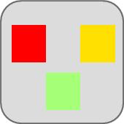

Traditional application approach
Microservices application approach
A traditional application has most of its functionality within a few processes that are componentized with layers and libraries.
Scales by cloning the app on multiple servers/VMs
App 1
A microservice application segregates functionality into separate smaller services.
Scales out by deploying each service independently with multiple instances across servers/VMs
App 1
App 2
Independent deployment and scale of microservices
Coarse-grained density of apps/services
Fine-grained density of services
Need to deploy and scale the full application
Notes:
Deployment models of monolithic vs microservices
Instantiate Services instead of spinning up new machines => faster
Better utilization of hardware
Optimize Cost
Lower time to market: more confident when it comes to upgrading a service
Services are independently:
- Implemented
- Deployed
- Scaled
- Versioned

Slide 9
How Monoliths Diminish Agility
Single codebase - singe release pipeline
All teams share code base/dependencies – tightly-coupled
All team share same release cadence
A defect in a dependency can block multiple teams and the release itself
Dev team A
Dev team B
Release
Production
Dev team C
Dev team D
Notes:
Why do we need to move to MSA?
#1 reason: Unified single code base with a single release pipeline.
A bug found in one team can block other teams and the entire release process
If feature A breaks, the other teams who depend on feature A are blocked as is the release
The more development teams, the less manageable it becomes

Slide 10
How Microservices Promote Agility
Each team owns it own service and codebase…
Services are isolated and do not directly share dependencies
Each service has its own release cadence
Each deploys independently
Dev team A
Release
Production
Dev team B
Release
Production
Dev team C
Release
Production
Dev team D
Release
Production
Notes:
With MSA, each team owns its service and deploys it separately into separate production environment
As each service exposes API endpoints, it is isolated from the others.
So even if one of the services has a problem, it doesn’t directly affect other services.
Question here might be, “How much change each release should include?“
Netflix allows to deploy only one significant change at a time.

Slide 11
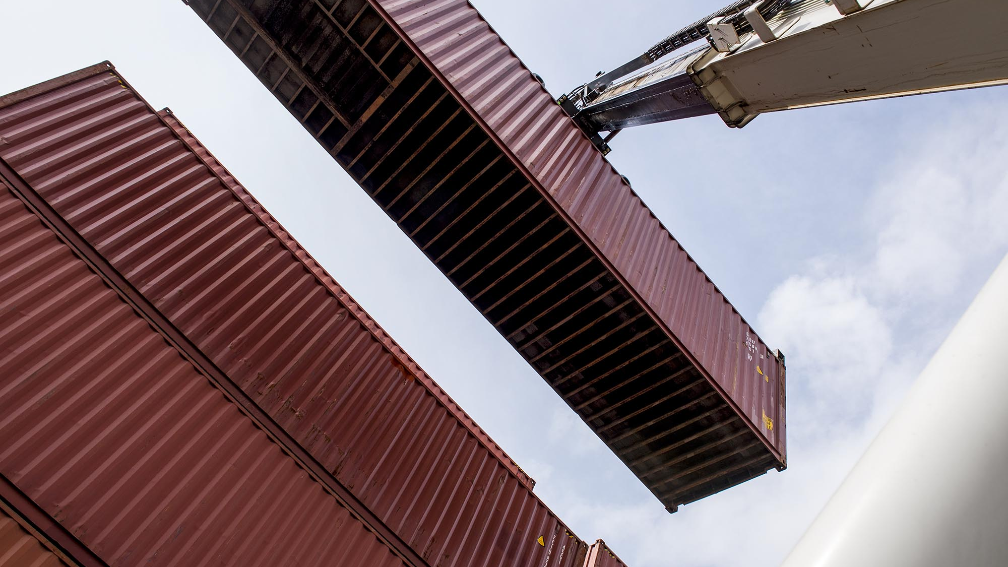
Kubernetes - Container Orchestrator

Slide 12
Challenges of a containerized world
As application development has moved towards a container-based approach, the need to orchestrate and manage the inter-connected resources becomes important
Load Balancing
Naming and Discovery
Logging and Monitoring
Debugging and Introspection
Networking
Notes:
“Container-centric infrastructure”
Additionally: configuration management, debugging/introspection, identity and authorization
First of all.. You can run containers w/o any further infrastructure. Docker, Images and Go..
But you’ll super quickly face issues – for example how to distribute containers in a cluster? Where to start my Containers? What happens when a container or a container host failed? How to I distribute requests across multiple instances of an application or service? How to measure and how to scale applications based on load?
Load Balancing
Distributing traffic across containers at scale
Naming and Discovery
How do containers or groups find one another?
Logging and Monitoring
Keeping track of what containers are doing
Debugging and Introspection
Getting inside running containers
Networking
Differentiating container networks from host networks at scale

Slide 13
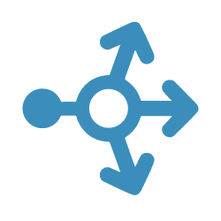
Application Scale
Web
Web
Web
Web
Web
API
API
API
Cache
Cache
Notes:
Here is a typical web environment <CLICK>
But we need to scale this <CLICK> <CLICK>
Add a load balancer <CLICK>
How would you configure an environment like this? Today you would need to configure a load balancer and add static ip addresses ext…..
This would not work in this environment where machines (containers) are constantly being moved around, added and deleted.
<CLICK>

Slide 14
Load Balancing & Fault Tolerance
NODE
Daemon
Containers
Image Cache
Web
Web
Web
Web
Web
Web
API
Cache
API
API
API
Cache
Cache
Notes:
Should all these containers be on a single host?? Probably not <CLICK>

Slide 15
The elements of orchestration
Scheduling
Affinity/anti-affinity
Health monitoring
Failover
Scaling
Networking
Service discovery
Coordinated app upgrades
Notes:
Hence, why we need an orchestrator:
Automates the deployment, management, scaling, networking, and availability of containers
Managers the lifecycle of containers in large environments
Allow users to guide container deployment and automate updates, health monitoring, and failover procedures

Slide 16
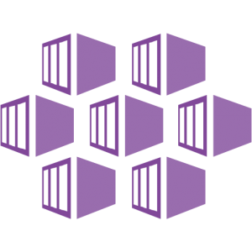

Container Orchestrators
Azure Kubernetes Service

Slide 17
Azure Kubernetes Service (AKS)
Fully-managed Kubernetes platform hosted in Azure as a PaaS service
Deeply integrated with Azure dev tools and services
Abstracts the complexity and operational overhead of managing Kubernetes
AKS implements K8s services, with a custom K8s config file optimized for Azure
AKS is a K8s managed service w/in Azure
At no charge…
Automated upgrades, patches
High reliability, availability
Automatic scaling
Self-healing
Monitoring

Slide 18


Control Plane
MASTER NODE
At no charge…
Automated upgrades, patches
High reliability, availability
Automatic cluster scaling
Self-healing
Monitoring
MASTER NODE
Daemon
Daemon
Containers
Image Cache
NO CHARGE
Containers
Image Cache
Container Scheduling
Container Orchestration
NODE
NODE
NODE
Daemon
Daemon
Daemon
Containers
Image Cache
Containers
Image Cache
Containers
Image Cache
Web
Web
Web
Web
Web
Web
API
Cache
Web
Web
API
Cache
API
Cache
API
Cache
API
Cache
API
Cache
Notes:
Azure Kubernetes Service is Kubernetes, optimized for Azure. The control plane is managed for you at no additional cost. You pay for the VM Nodes at your enterprise discount.
Azure Kubernetes Service (AKS) is a free container service that simplifies the deployment, management, and operations of Kubernetes as a fully managed Kubernetes container orchestrator service.
Paying for only the virtual machines, and associated storage and networking resources consumed makes AKS the most efficient and cost-effective container service on the market.

Slide 19
AKS Features
High Availability
High Reliability
Cluster Autoscaler
Security
Monitoring
Availability Zones
99.95% SLA
Self-Healing
Node Autoscaler
Virtual Nodes
Azure Key Vault
Azure Active Directory
Private Clusters
Azure Log analytics with Container Insights
Notes:
Availability Zones provide a higher level of availability to protect against a hardware failure or a planned maintenance event
Node Autoscaler - This ability to automatically scale up or down the number of nodes in your AKS cluster lets you run an efficient, cost-effective cluster. https://docs.microsoft.com/en-us/azure/aks/cluster-autoscaler
Virtual Nodes - To rapidly scale application workloads in an AKS cluster, you can use virtual nodes. With virtual nodes, you have quick provisioning of pods, and only pay per second for their execution time. Can handle overflow while nodes are being added to cluster.
Monitoring – a single analytics dashboard for all of Azure including Kubernetes. Can be used along with Promethius
https://docs.microsoft.com/en-us/azure/aks/monitor-aks

Slide 20
AKS – References
Documentation, learn, best practices, industry use cases

Slide 21

AKS References
Azure Kubernetes Service landing pages
Azure Kubernetes Service portal
Azure Kubernetes Service pricing
Azure Kubernetes Service documentation
Azure Kubernetes Service education
Azure Kubernetes Service learning path
Azure Kubernetes Service 50 days challenge
Azure Developer Cloud Skills Challenge

Slide 22
Container Orchestrators
Additional Container Options

Slide 23
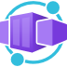
Azure Container Apps
Run your container app on a serverless platform
Used to build Kubernetes style applications without access to native Kubernetes APIs
Dynamically scale based on
Http Traffic
Event-driven processing
CPU or memory load
Any KEDA-supported scaler
https://docs.microsoft.com/en-us/azure/container-apps/overview
Notes:
https://docs.microsoft.com/en-us/azure/container-apps/overview

Slide 24

Azure Arc-enabled Kubernetes
Attach Kubernetes clusters running anywhere (on-premises or other Cloud vendors)
Your cluster will show up in Azure Resource Manager
Your cluster will be placed in an Azure subscription and resource group
Your cluster will receive tags like any other Azure resource
https://docs.microsoft.com/en-us/azure/azure-arc/kubernetes/overview
Notes:
https://docs.microsoft.com/en-us/azure/azure-arc/kubernetes/overview

Slide 25
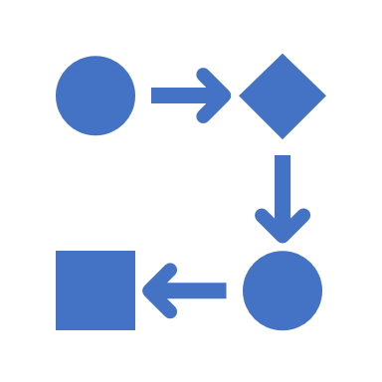

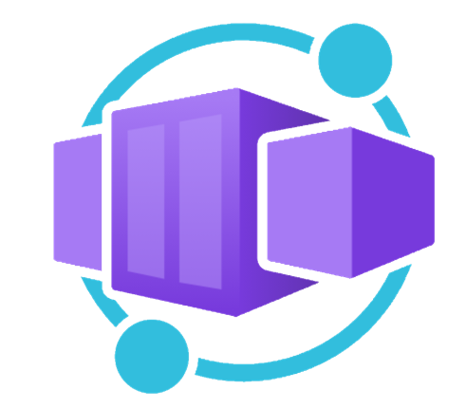




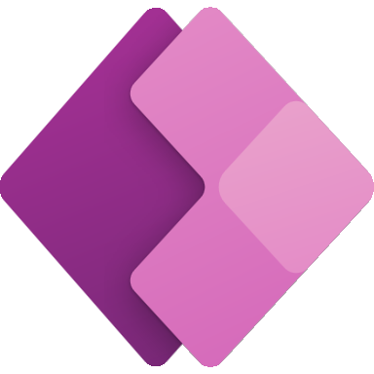
Application hosting continuum
IaaS
Infrastructure Platform
CaaS
Container Orchestration
Platform
PaaS
Application Platform
FaaS
Serverless Platform
Low Code
App and Orchestration
Platform
Virtual Machines
Azure Kubernetes
Service
Azure Container Apps
Azure Spring Apps
Azure App
Service
Azure Functions
Azure Logic
Apps
Power Apps
More Control of execution environment
Less Control of execution environment
Less Agile development & deployment
More Agile development & deployment

Slide 26


Sign up for Microsoft.Source
Thank you!
Receive a regular digest of relevant technical content, events and training
Get the best of the newest resources, tools and guidance to help developers quickly build and deploy on Azure
Please fill out the Azure Dev Day Survey!
aka.ms/azuredevdaysurvey
And visit our event content page to access lab materials, presentations and more about the Microsoft Build Conference!
aka.ms/azuredevdaycontent
Get the latest articles, documentation, and events from Microsoft.Source—the curated monthly developer community newsletter.
Stay at the forefront of rapidly evolving technologies with resources that are relevant to your field, location, and areas of interest—including articles, GitHub repositories, and how-to guides.
Get notified about events—from local hacks, workshops, and training sessions to virtual meetups and global conferences.
Learn what you want, when you want, how you want. Resources include in-person hands-on workshops, free, interactive online training and sandbox environments.

Slide 27
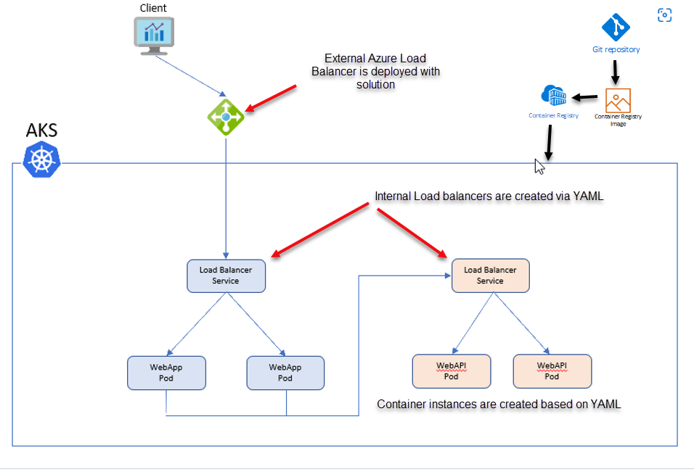
Microservice Solutions Lab
Deploy containers to AKS
aka.ms/azuredevdaylabs/microservices
Azure Dev Day
Notes:
https://aka.ms/azuredevdaylabs

